Slide 2




Agenda
01
Introduction
Why MoodPod?
02
User needs & Functions
Identifying necesarry functions
03
Building the Solution
Building & Managing the solution, Live Demo
04
Conclusion
Outlook & Questions

Slide 3
Introduction
Why MoodPod?

Slide 4
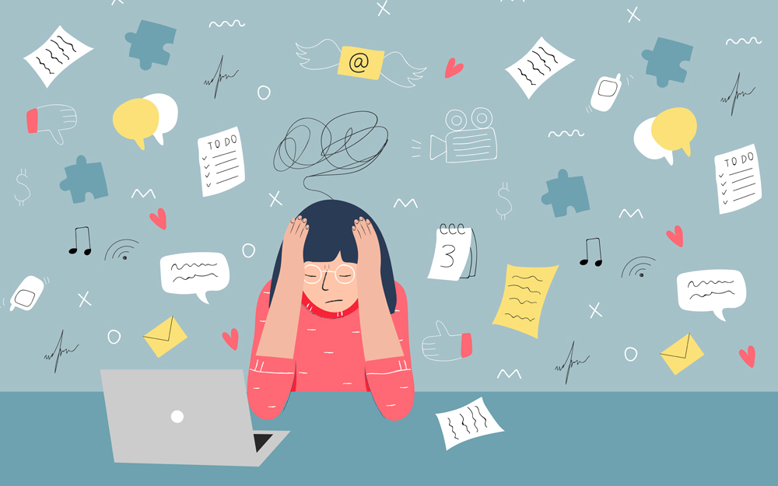
Motivation
Stress has significant impact on physical and mental health
Work-related stress is the most prevalent one
Burnout as the result
3rd “good health and well-being”& 8th SDG “decent work and economic growth”

Slide 5
Objective
Track
Track stress level of the user
Analyse
Analyse potential threats (e.g. burnout)
Relieve
Relieve stress through information (&routines)

Slide 6
User needs & functions
Identifying necessary functions

Slide 7

SURVEY
Notes:
Frage ans Publikum
How stressful is your work day?
Which triggers for stress in a work day?
Can you track your stress-level?

Slide 8




Key Insights
Overall stress is high
Assessing one’s stress level is hard
Necessary functions
Workload, missing communication & private stress as triggers
Notes:
Overall Stress: <50% (stressful) - 75% (extremely stresssful)
Stress level: slightly more than 70% are unsure or cannot asses their stress level
Functions: Uncomplicated Input, Feedback, and Routines

Slide 9
Building the Solution
Building & Managing the solution, Live Demo

Slide 10

Questionnaire
35 questions to start
Seven different categories
All can be answered with Yes or No
Based on Work-Stress Questionnaire by Holmgren et. al. 2009
Notes:
Categories: Workload, Clarity of Tasks, Responsibility and Influence at work, Mentality, Conflicts, private life, general health
Do you think about work after your work day?
Are youi bothered by headaches at work occasionally?
DO you have time to finish your assignments?
Auch in die andere Richtung?

Slide 11
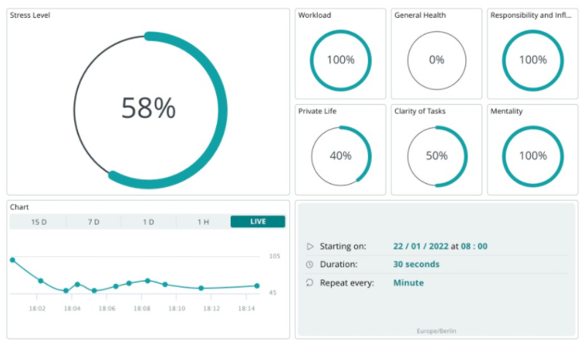
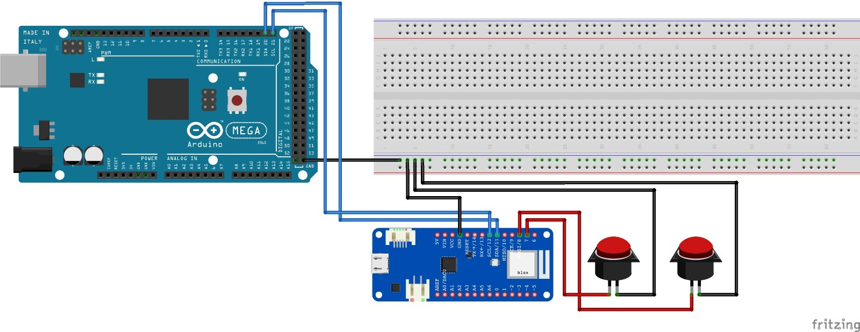
Hardware & Software
Arduino Mega 2560, MKR 1010 Wifi
IoT-Cloud
9 classes, 590 lines of code
Two-Button Feedback
Dashboard
Scheduler to present Questions to the user
Responsive Questions (through Questionnaire)
Notes:
I2C-Communication between Mega und dem anderen
MKR is MASTER
MEGA is SLAVE für display

Slide 12
How does it work?
Start
Select a category
Present a question
yes
Button Input
no
Check impact on stress level
Check impact on stress level
Update overall and specific stress level
Update overall and specific stress level

Slide 13
LIVE DEMO

Slide 14
Conclusion
Outlook & Questions

Slide 15

Outlook
Notes:
Routines, Pictures, Apps, Weather
Differrent Cases, Distribute and not Do-it yourself approach
Get users or companies to use the product

Slide 16
THANK YOU FOR YOUR ATTENTION!

Slide 17
Additional Ressources

Slide 18
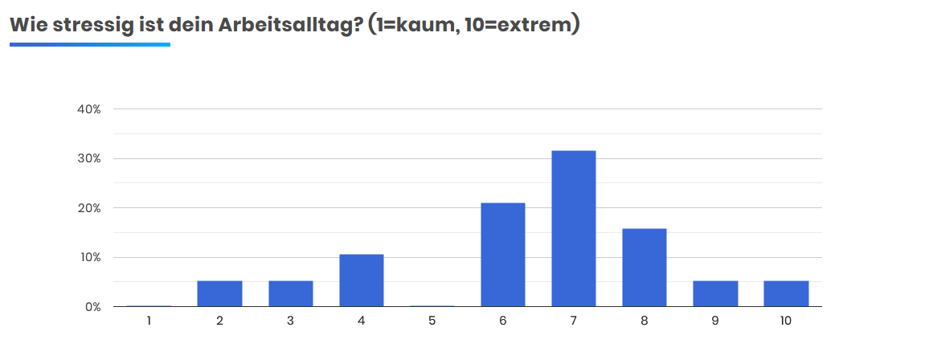
Key Insights Survey (1/4)

Slide 19
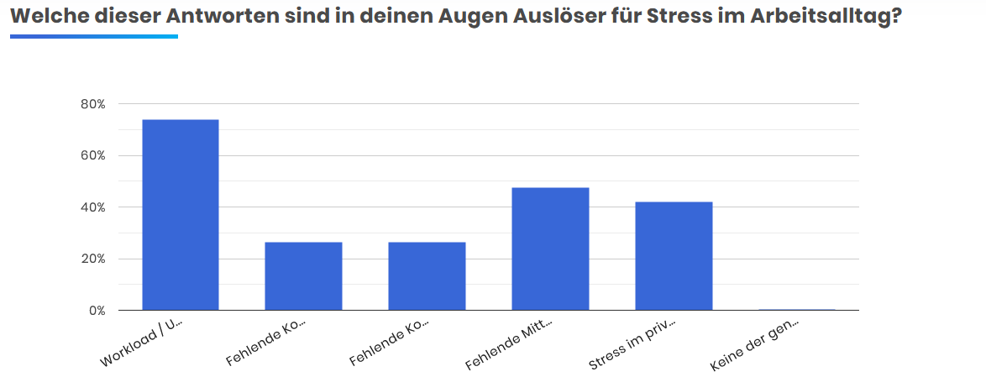
Key Insights Survey (2/4)

Slide 20
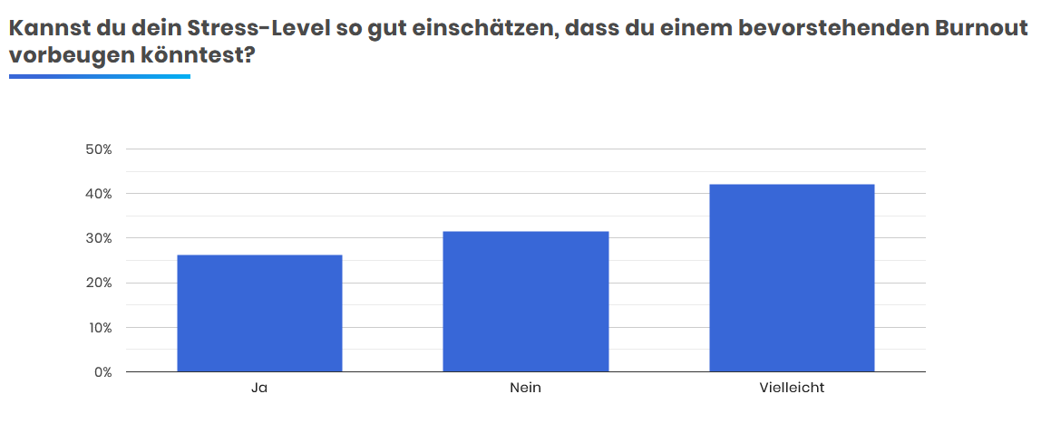
Key Insights Survey (3/4)

Slide 21
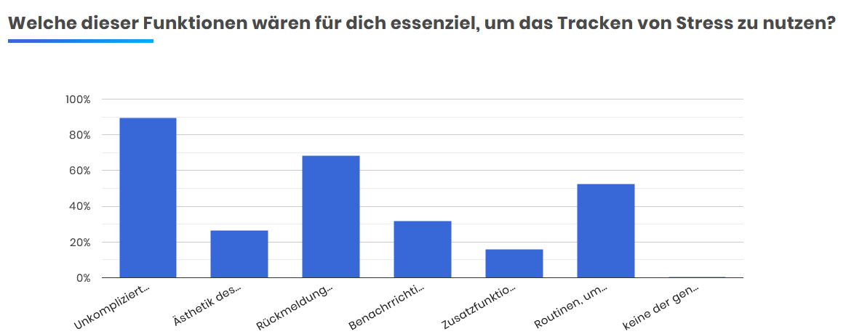
Key Insights Survey (4/4)

Slide 22
Circuit diagram

